Slide 1
Tabula
Jose Guzman

Slide 2
Where did the game originate & possible date of origination?
According to the Etymologiae by Isidore of Seville, tabula was first invented by a Greek soldier of the Trojan War named Alea.
Around 6th century Ad

Slide 3
How do we know the game existed?
We know the game existed because it was recorded in history.

Slide 4
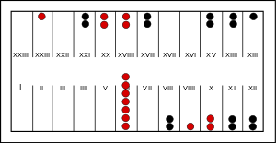
What did the game pieces (board) look like?
Like this →→→→→→→→

Slide 5
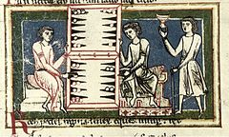
How many players were required?
There were only two players required.

Slide 6
Do actual rules of game play exist?
Yes, actual rules of the game exist.

Slide 7
How do you play the game?
This is a game for two people. It is a simple version of Backgammon. The aim is to get your 15 counters along the bottom of the board and back across the top.
Black starts. Click on the dicebox to shake and throw the dice. The three dice will appear. Click on one of them to show which you're going to use first. Then click on a counter that you want to move. At first, of course, it will be a counter stacked up before the start. Later on, you can choose one of the counters on the board, if you wish. When you have chosen a dice and counter, the computer will move it for you. You don't need a special number to start. Choose a second dice, and counter, then the third. Then click on the dicebox again for White's go. Both White and Black go the same way round the board, counter-clockwise.
You can have as many of your own counters on one square as you wish. They stack into a neat pile! If your move would end by landing on a group of your opponents counters (more than one) then you are blocked and can't do that move. (You can still use the same dice for a different move.) However, if your move ends by landing on a single piece of your opponents, then you stay there, and the opponent's counter gets sent home. That is obviously an advantage to you, so try to do it when you can. To stop it happening to you, try to avoid having single counters on a square wherever possible.
You cannot move onto the top of the board (past XII) until all your counters have started. If you can sent back home, then you must restart that counter before moving any counters on the top half of the board. (This tends to bundle all the counters together at the start of the game, which makes it more interesting!)
You cannot finish any counters until all your counters are in the last quarter of the board (past XVIII). Once they are there, you can move any counter off the board as long as you have a dice throw which takes them past XXIV. You don't need an exact number to move a counter off. (This tends to bundle the counters together at the end of the game, which also makes it interesting.)
You may find that you are unable to move. If so, click on the Can't go button. If you can go, then you must, even if it puts you in a more exposed position. This is part of the fun of the game!

Slide 8
How long does it take to play a game?
It depended on the people playing the match.

Slide 9
Are there other names for the same game?
Yes, “table” or “tablet”

Slide 10
Is the game related to other ancient games?
No, It doesn’t really relate to other ancient games.

Slide 11
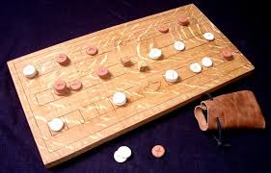
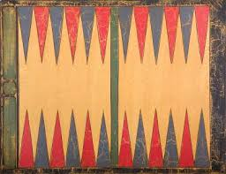
Photos

Slide 12
The End!!!

